Slide 1
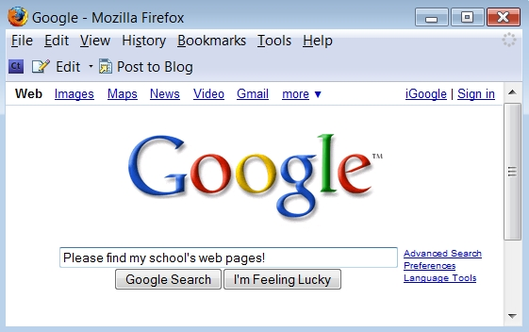
What you can see in the picture?

Slide 2
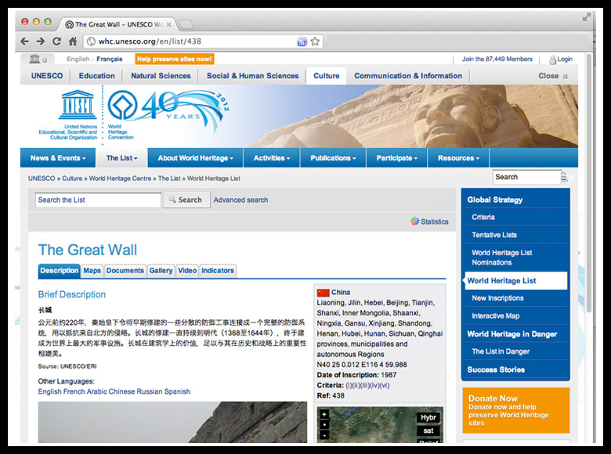
Here

Slide 3
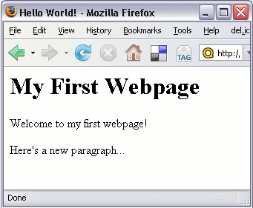
And here

Slide 4
Well Said!
These are Web Pages

Slide 5
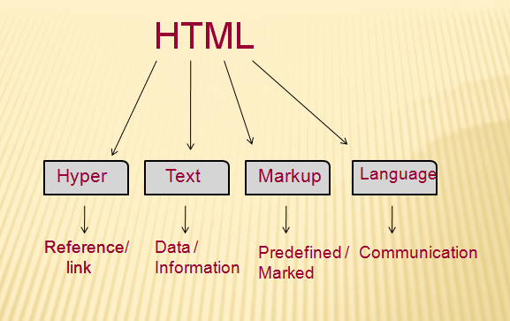
Web Pages are created using language

Slide 6
English language is used to write books
HTML is used to create Web Pages.

Slide 7
HTML Syntax
HTML syntax:
two-sided tag:
<tag attributes>document content</tag>
Closing tag
Starting tag
Properties of the tag.
Optional!
Actual content appears in webpage. It could be empty
Examples: <p> CGS 2100 </p>
<body bgcolor = “yellow”> UCF </body>

Slide 8
HTML Syntax
HTML syntax:
one-sided tag:
<tag />
e.g. Breaking line tag: <br/>
Horizontal line tag: <hr/>

Slide 9
Structure of the web page
Starting with the tag <html>...</html>
<html>
.......
</html>
Everything about the web page should be enclosed here

Slide 10
Structure of the web page
Inside the <html></html> tag
  Each web page has a head part described in <head></head> tag:
<html>
<head>
<title> CGS 2100 </title>
</head>
</html>
The title of the web page should be put here

Slide 11
Structure of the web page
Inside the <html></html> tag
  Each web page has a body part described in <body></body> tag:
<html>
<head>
<title> CGS 2100 </title>
</head>
<body>
This is a sample HTML file.
</body>
</html>
The content of the whole web page should be put here

Slide 12
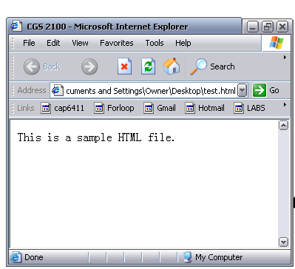
Title
Body

Slide 13
Create a basic HTML file
Open your text editor (notepad).
Type the following lines of code into the document:
<html>
<head>
<title> CGS2100 lab section</title>
</head>
<body>
This is a sample HTML file.
</body>
</html>

Slide 14
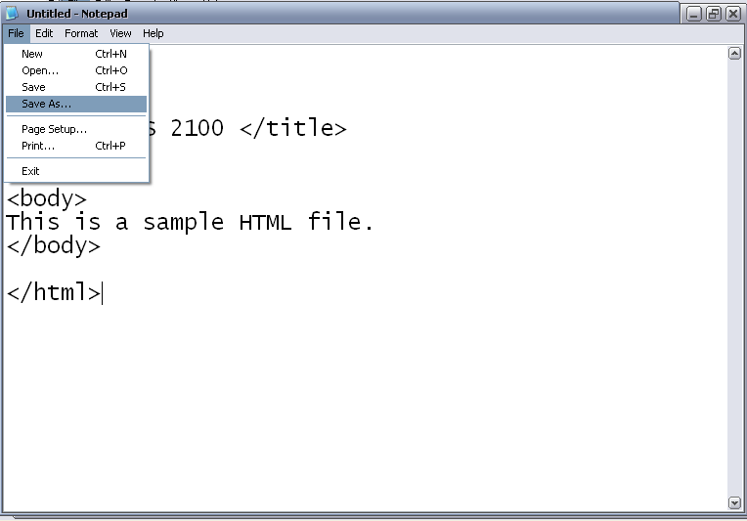
Create a basic HTML file (cont)
Save the file as sample.htm

Slide 15
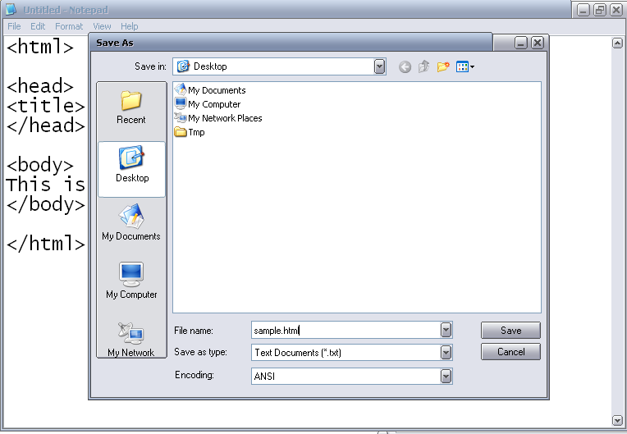
sample.html

Slide 16
Introduction to some common tags
Paragraph tag
List tag
Hyperlink tags

Slide 17
Paragraph tags <p>...</p>
<html>
<head>
<title> CGS 2100 </title>
</head>
<body>
<p> Here is the first paragraph. </p>
<p> Here is the second paragraph. </p>
</body>
</html>

Slide 18
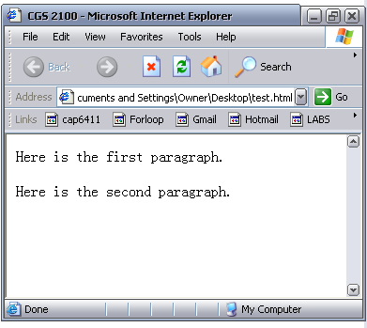
result
First paragraph
Space between paragraphs
Second paragraph

Slide 19
List tags
Ordered list: used to display information in a numeric order. The syntax for creating an ordered list is:
<ol > e.g. <ol >
<li>item1 </li> <li> Name: Riya Sen </li>
<li>item2 </li> <li> Section: 12B </li>
… <li> Instructor: Leela </li>
</ol> </ol>
Result: 1. Name: Riya Sen
2. Section: 1 2B
3 . Instructor: Leela

Slide 20
List tags
Unordered list: list items are not listed in a particular order. The syntax is:
<ul > e.g. <ul >
<li>item1 </li> <li> Name: Riya Sen </li>
<li>item2 </li> <li> Section: 12B </li>
… <li> Instructor: Leela </li>
</ul> </ul>
Result:
Name: Riya Sen
Section: 1 2B
Instructor: Leela

Slide 21
Hyperlink
Link to another location or file
Syntax:
<a href= “http://www.google.com”> Click to open google </a>
Content displayed on the page
Starting Tag
Attribute of the tag: the address of the hyperlink
Ending tag

Slide 22
Link
Link to web site
  <a href= “http://www.google.com”> google</a>
Email link
<a href= “mailto:name@domain.com”> Link to email </a>

Slide 23
Include a Picture
<img src=“FILENAME” />
<img src=“FILENAME” alt=“text” />
E.g.
<img src=“logo.gif” alt=“Google logo” />
<img src=“logo.gif” />

